Slide 1
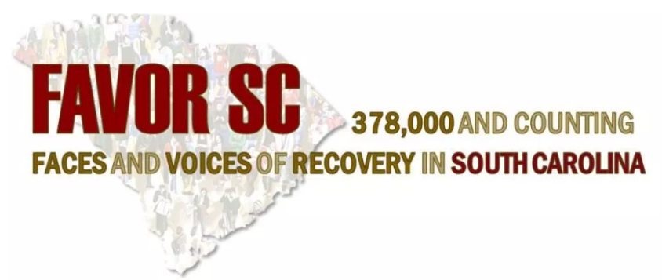
South Carolina Department of Alcohol and Other Drug Abuse Services Recovery Services & Work with FAVOR SC

Slide 2
Workforce Vision
South Carolina will have a stable, competent, multidisciplinary workforce that is qualified and adequate in number to ensure effective prevention, intervention, treatment and recovery services for substance use disorders.
Priority to develop peer support services
Notes:
Ultimately our vision is that
South Carolina will have a stable, competent, multidisciplinary workforce that is qualified and adequate in number to ensure effective prevention, intervention, treatment and recovery services for substance use disorders.

Slide 3
MAT Demand
Treatment Provision
Methadone & Therapy access to 118 Pregnant Women
Notes:
We have seen over a 200 percent increase in the last year in the number of patients we are supporting financially to receive the evidence-based treatment for opioid use disorder. These are uninsured patients who would likely not otherwise receive high quality care.
There are currently 300,000 people in recovery in the State of South Carolina

Slide 4
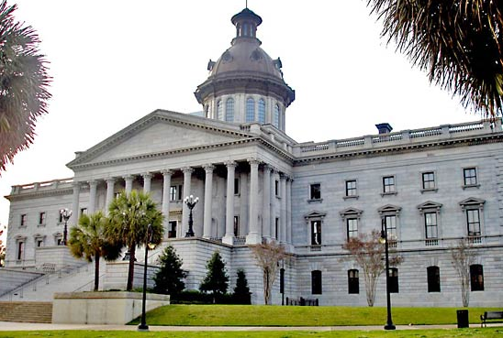
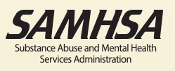
Maximizing Assets to Support Recovery
State Targeted Response Grant
State Opioid Response Grant
Drug Free Communities
Recovery Community Organizations
Prevention Programming Community Coalitions Overdose Reversal Peer Support Treatment

Slide 5
Success Incorporating Recovery
Certified Peer Support Specialist Training
Emergency Department Stabilization
Peer Intervention with Law Enforcement
Engagement in Treatment and Transition Supports
Peer Support for Inmates (Jails and Prisons) & Drug Courts
Family

Slide 7
Notes:
Language Matters.
Language is the key to changing the way people with substance use disorders see themselves and the way they are seen by others.
We can use language to start to bring equity to people and to a disease state that for so long has been marginalized and criminalized.
Changing language is a way to personally and culturally close one chapter in our history and open another. And that’s a big part of this campaign
The term “substance abuse” for example is judgmental, stigmatizing and behavioral not medical. Most importantly “abuse” is associated, by the general public, with “Domestic Abuse” and “Child Abuse” neither of which have positive connotations. Additionally, folks with a Substance Use Disorder did not abuse their drugs, they treated them like the important things they were to them at the time.
With prescription medications the more accurate term is “misuse”. With the implementation of DSM V “Substance Abuse and Dependence” have been replaced with “Substance Use Disorder” which is a more neutral, medically appropriate term. You can also point out they distinction between addiction and dependence especially with opioids.
All of these are terms that you see here on the slide with the possible exception of “they are in denial” are not used in reference to any other chronic medical condition. They are all stigmatizing and are in line with the paradigm of Substance Use Disorder being “willful misconduct” (or behavioral) versus medical. We use this cheat sheet in my office a lot with new staff to change the antiquuated language norms that we bring to this work.

Slide 8
Working to fight stigma
Personal: Self-disgust, shame and self-hate at one’s own appearance, behavior, lifestyle and/or physical condition, as well as feelings of being unworthy of help or recovery.
Social: Negative perceptions, labels and actions from friends or family; feeling isolated or rejected.
Institutional: Negative treatment and attitudes experienced from healthcare providers, the media, law enforcement, places of work or government agencies.
Stigma Discriminatory Practices

Slide 9
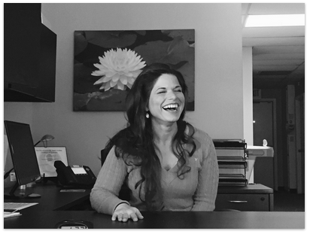
Recovery is Possible!
Katy Austin says she found prison before she found treatment and recovery.
Notes:
There are currently 23 million people in recovery in the United States
There are currently 300,000 people in recovery in the State of South Carolina
When we think about recovery communities in rural areas, it’s easy to imagine how stigma, and cold-shoulders in tight-knit villages could have some negative consequences for these folks who are especially vulnerable.

Slide 10
Twelve Step Groups (A.A./N.A)
Church-Based Groups
Outpatient Treatment
Intensive Outpatient Treatment
Medication Assisted Treatment
Residential/Inpatient Treatment

