Slide 1
Future of the Prevention Field and Prevention Across the Continuum, Agencies, and Populations
Frances M. Harding, Director
Center for Substance Abuse Prevention
Substance Abuse and Mental Health Services Administration
U.S. Department of Health and Human Services
SAMHSA/CSAP Prevention Leadership Summit
Bethesda, MD — May 22, 2018

Slide 2
Objectives
HHS/SAMHSA update
Ongoing challenges and emerging substance use issues
SAMHSA program funding
Future directions for prevention and technical assistance services

Slide 3
HHS and SAMHSA Leadership

Slide 4
CSAP FY 2018 Omnibus Appropriation (Dollars in thousands)

Slide 5
FY18: Increased Resources
Substance Abuse Treatment: $3.18B, increase of $1.05B from FY17
New $1B opioid grant program
$50M set-aside for tribes
15 percent set-aside for states hardest hit
Includes prevention, treatment, and recovery language
MAT PDOA increased by $28M (total - $84M)
Pregnant & Postpartum Women increased by $10M (total - $29.9M)
Criminal Justice increased to $89M ($70M for Drug Courts)
BCOR (peer specialist training programs) increased by $2M (total - $5M)
MFP note: addiction psychiatry, addiction medicine, psychology (increased by $1M to total of $4.5M)

Slide 6
Trends in Death Rates for Different Substances
Heroin: Heroin-involved overdose deaths more than quadrupled between 2010 and 2015.
Synthetic opioids (e.g., fentanyl)*: 79 percent increase in deaths between 2014 and 2015.
Psychostimulants⁺: 255 percent increase in deaths since 2005.
Cocaine: 25.2 percent increase in deaths between 2014 and 2015.
Marijuana: 38 percent increase in the number of monthly marijuana users over the past 10 years.
Source: U.S. Department of Justice, Drug Enforcement Administration (2017).

Slide 7
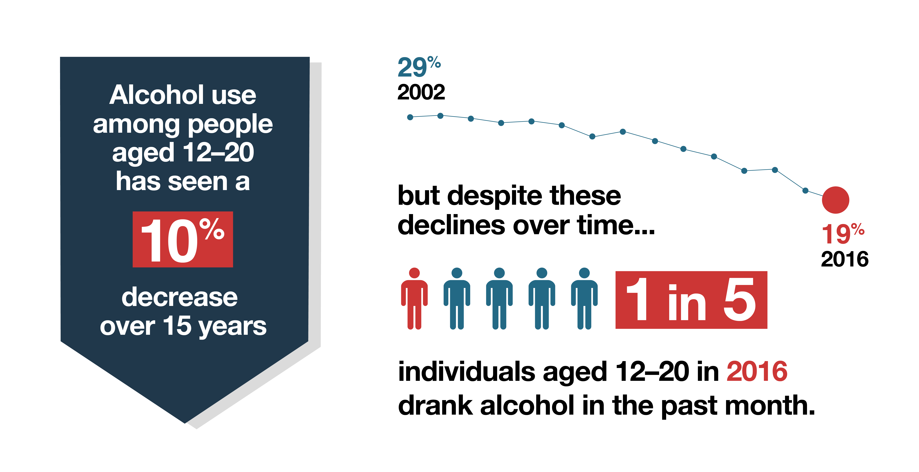
Prevention Success: Youth Alcohol Use

Slide 8
Health Risks of Electronic Cigarettes
Typically contain nicotine.
Typically have fewer chemicals than regular cigarettes but may contain other dangerous ingredients.
According to the 2015 National Youth Tobacco Survey:
13.5 percent of middle school and 37.7 percent of high school students had tried e-cigarettes
Past-30-day use for students in grades 6–12 had increased from 1.1 percent in 2011 to 11.3 percent in 2015
81.5 percent of current youth e-cigarette users said they used e-cigarettes “because they come in flavors I like.”
Sources: NIDA (2018); Smokefree.gov (n.d.).

Slide 9
JUUL and Similar Devices
One e-cigarette device, JUUL, represented more than half of e-cigarette sales as of March 2018.
FDA has taken steps to address youth use of and access to JUUL and other e-cigarettes as part of a new Youth Tobacco Prevention Plan.
Source: Public Health Law Center (2018).

Slide 10
Deaths Due to Opioid Overdose

Slide 11
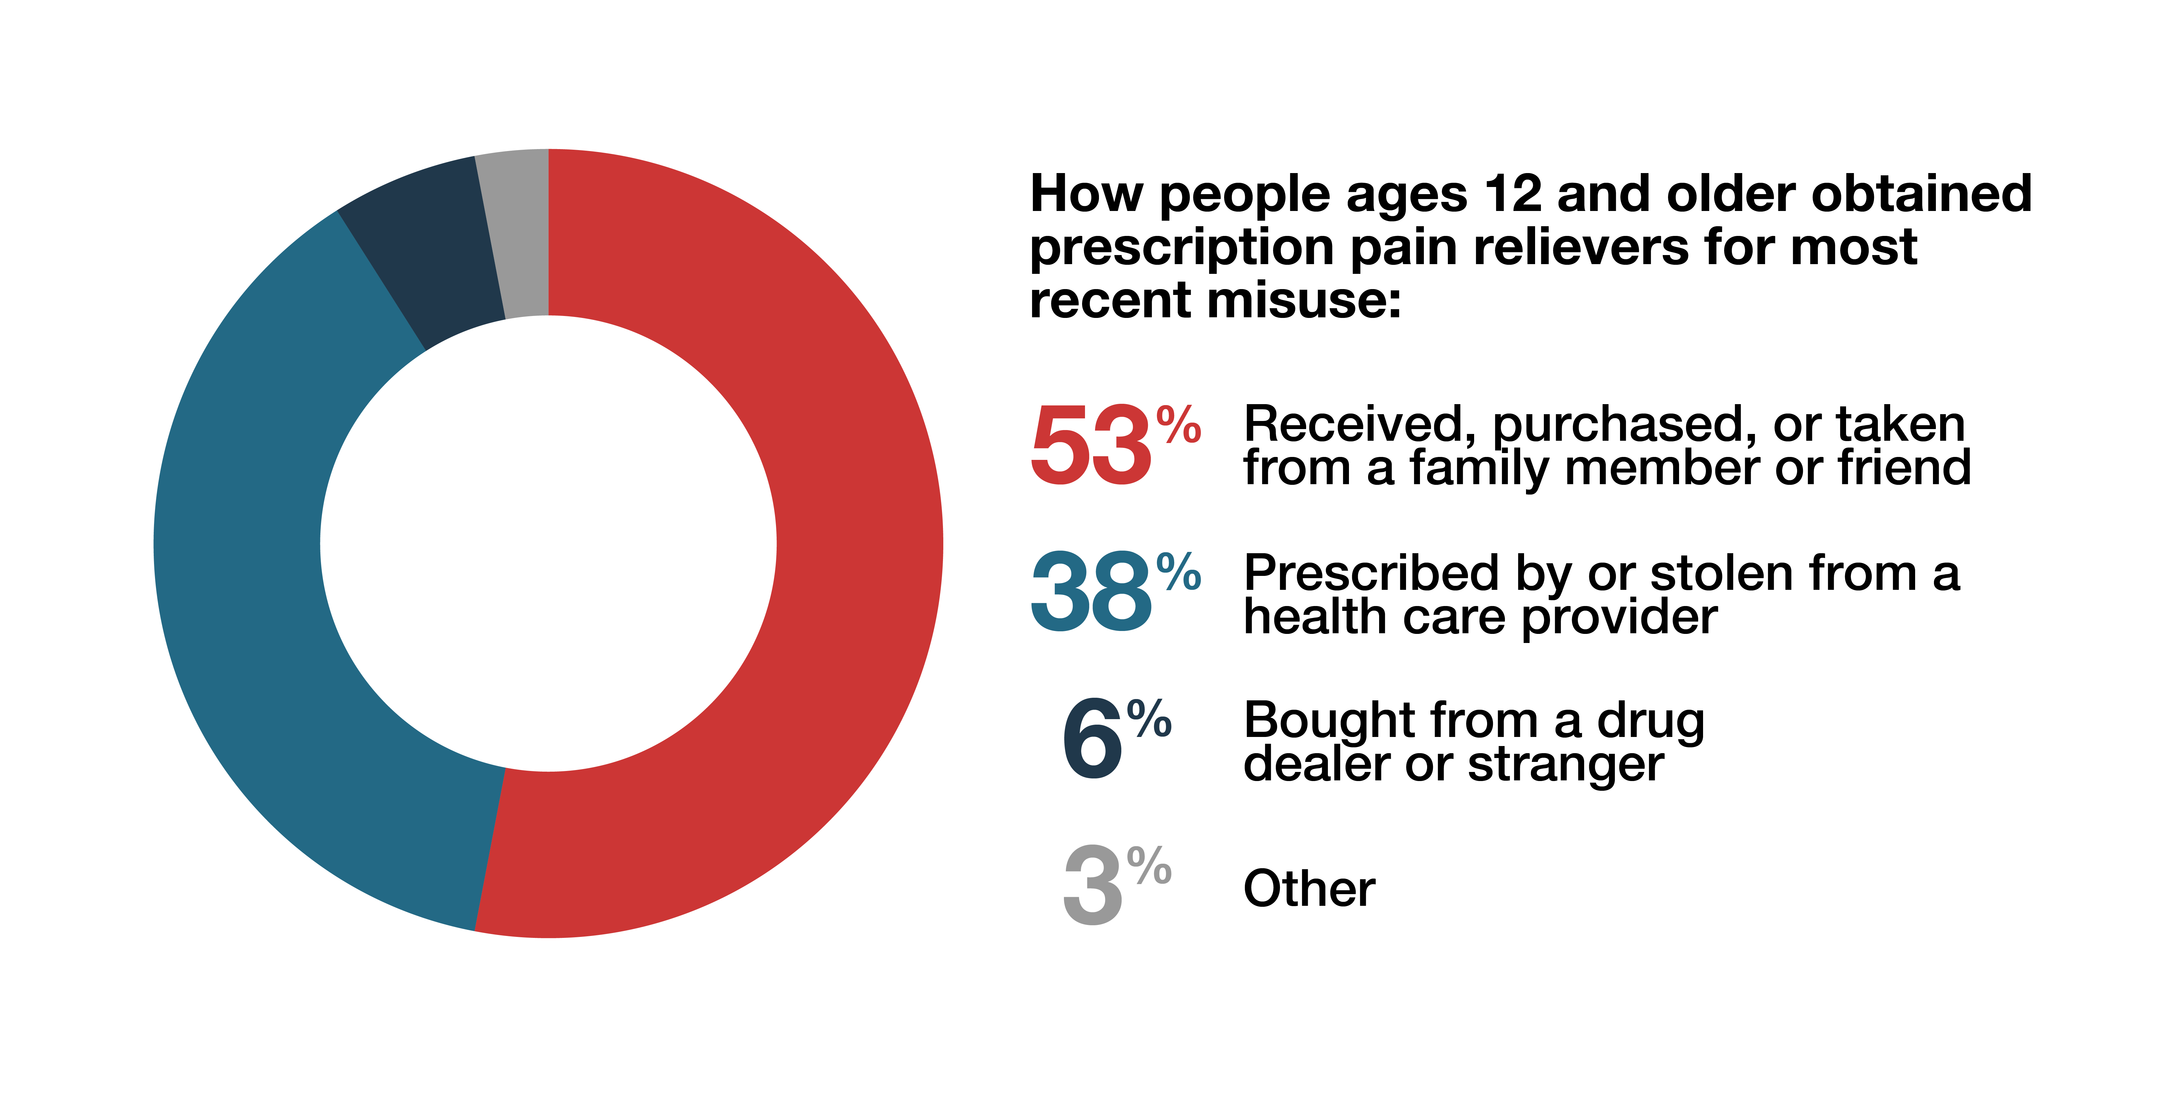
Sources of Prescription Pain Relievers
11
Source: National Survey on Drug Use and Health (2017).

Slide 12
Prevention Grant Programs
First Responders – Comprehensive Addiction and Recovery Act
(FR-CARA)
Community-Based Coalition Enhancement Grants to Address Local Drug Crises
Strategic Prevention Framework – Partnerships for Success (SPF-PFS) *2018 round – UAD and up to two other priorities
Strategic Prevention Framework – Prescription Drugs (SPF-Rx)
Grants to Prevent Prescription Drug/Opioid Overdose-Related Deaths (PDO)
Improving Access to Treatment
State Targeted Response to the Opioid Crisis Grants (Opioid-STR)

Slide 13
SAMHSA’s Technical Assistance Approach
Moving away from a contractor-driven approach to grantee-specific TA
Emphasis on use of local expertise and experience
Additional funds to grantees to procure TA services

Slide 14
Prevention Technology Transfer Centers FOA
Purpose: Provide training and technical assistance services to the substance abuse prevention field
Funding: $7.5M
Due date: July 10, 2018
Awards: 13 PTTCs
National coordinating center ($500K)
10 regional centers (up to $600K each)
Tribal Affairs center (up to $500K)
Hispanic and Latino center (up to $500K)

Slide 15
Questions and Discussion

