Slide 1
Recovery Housing & Initiatives
in Massachusetts
Allison F. Bauer, JD, LICSW
Director, Bureau of Substance Addiction Services, Massachusetts Department of Public Health
Substance Abuse and Mental Health Services Administration
U.S. Department of Health and Human Services
National Association of State Alcohol and Drug Abuse Directors Annual Meeting

Slide 2
Agenda
Introduction
Sober Housing
Recovery Support Centers
Peer Workforce
Conclusion

Slide 3
Introduction
BSAS is the Single State Authority
Prevention – Intervention – Treatment – Recovery
Development & Funding Support
Quality of Care
Licensing of Treatment Facilities
Licensing of Addiction Counselors

Slide 4
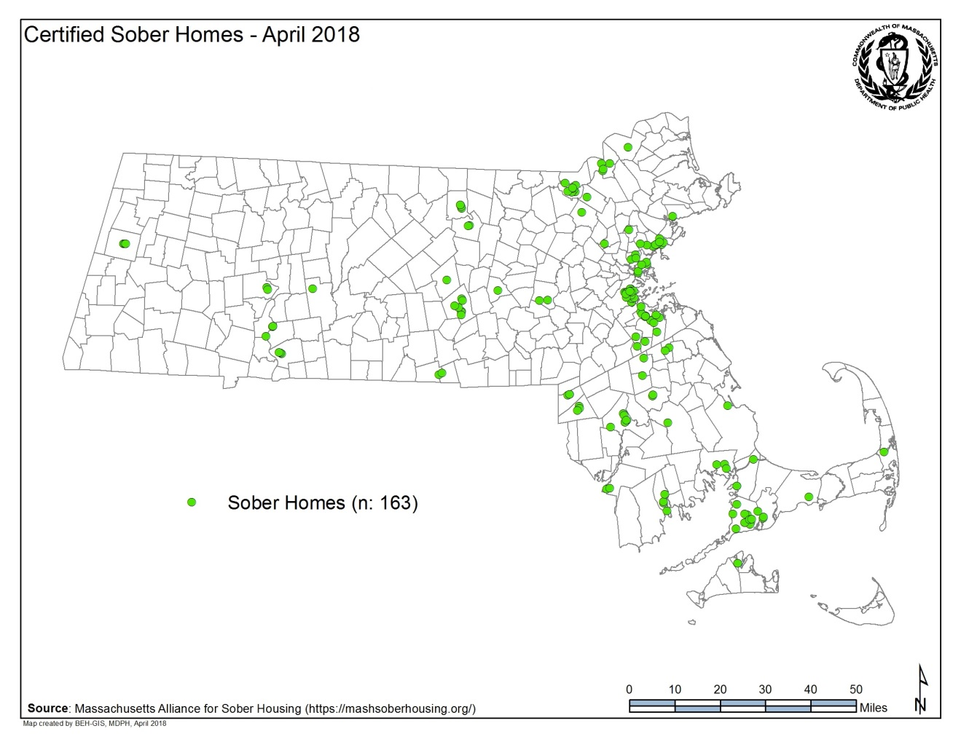
Sober Housing in MA
A Sober Home is a broad term describing a sober, safe and healthy living environment that promotes recovery from alcohol and other drug use and associated problems.

Slide 5
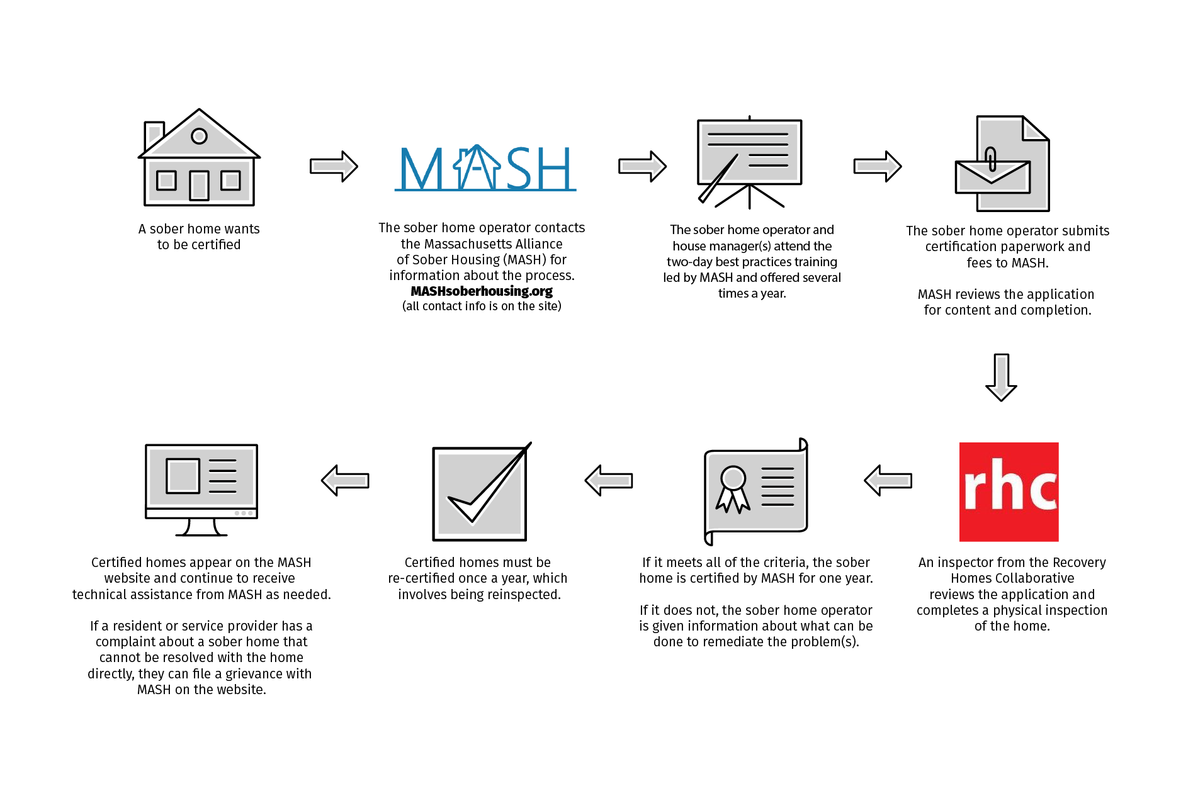
Sober Housing in MA – Certification Process

Slide 6
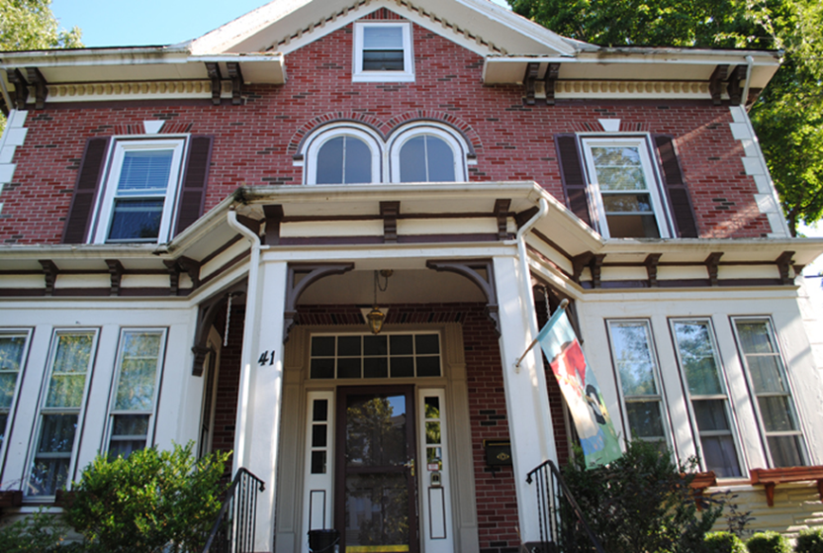
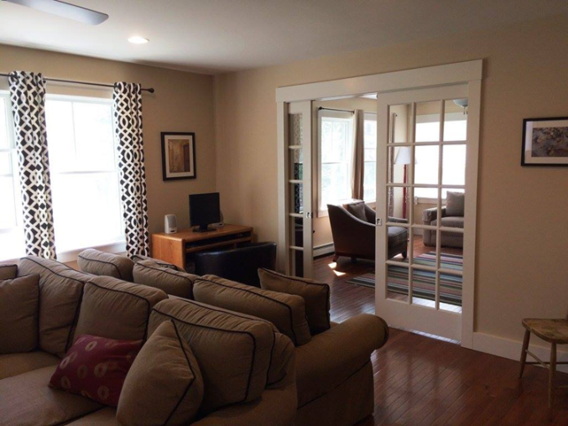
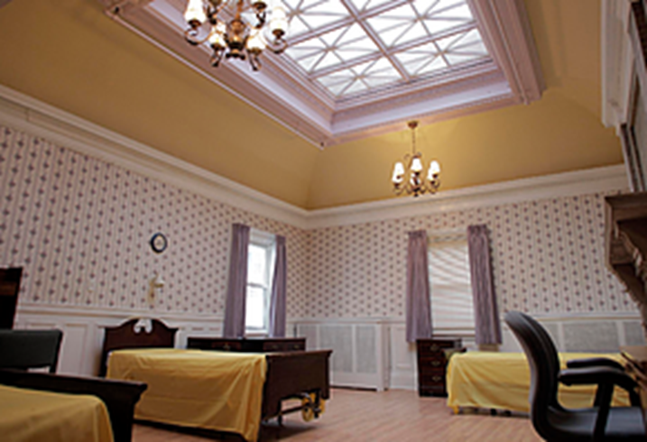
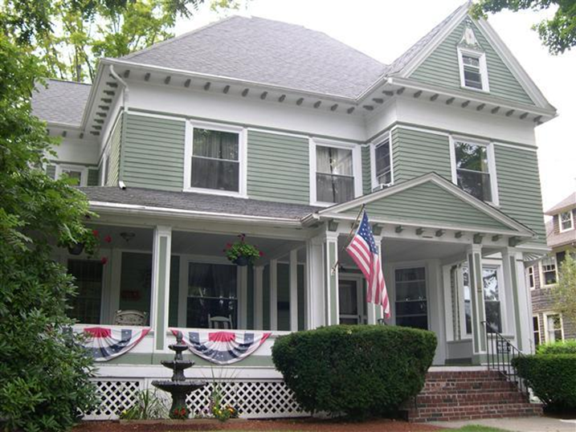
Sober Housing in MA
HOW House in Boston, MA
Vineyard House in Vineyard Haven, MA
ASL House in Attleboro, MA
Kelly House in Wakefield, MA

Slide 7
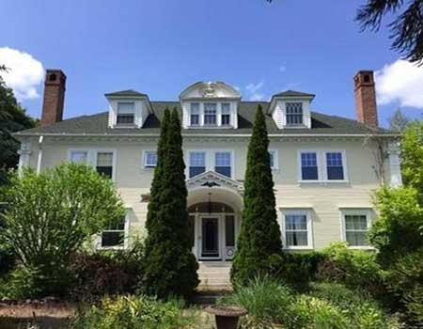
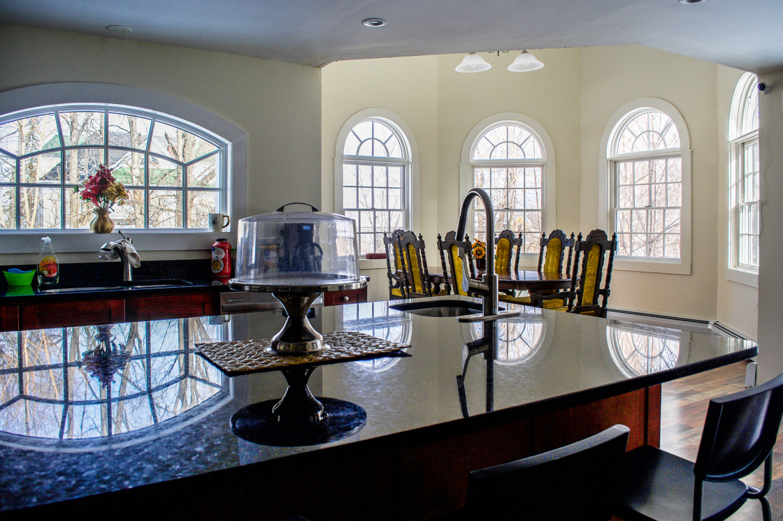
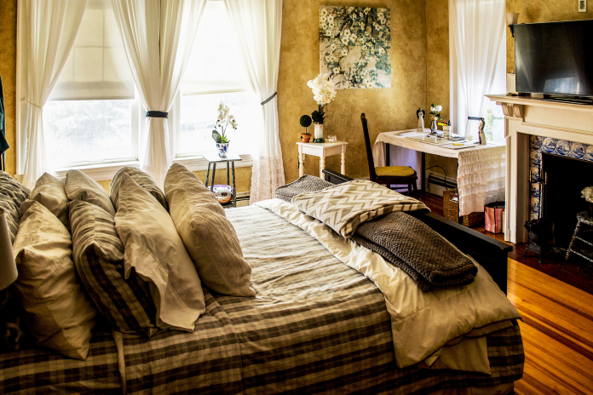
The Living House in Lawrence, MA

Slide 8
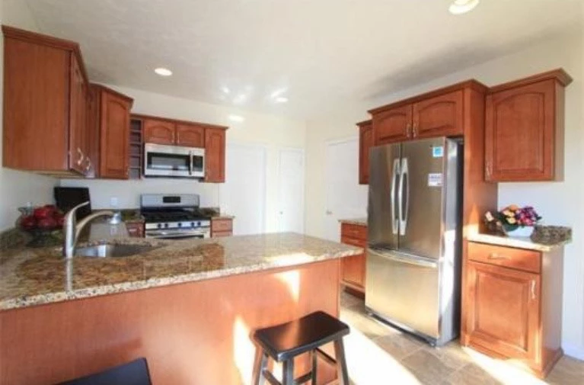
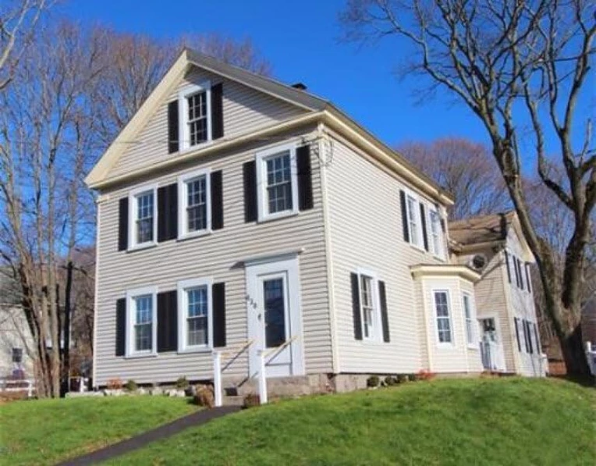
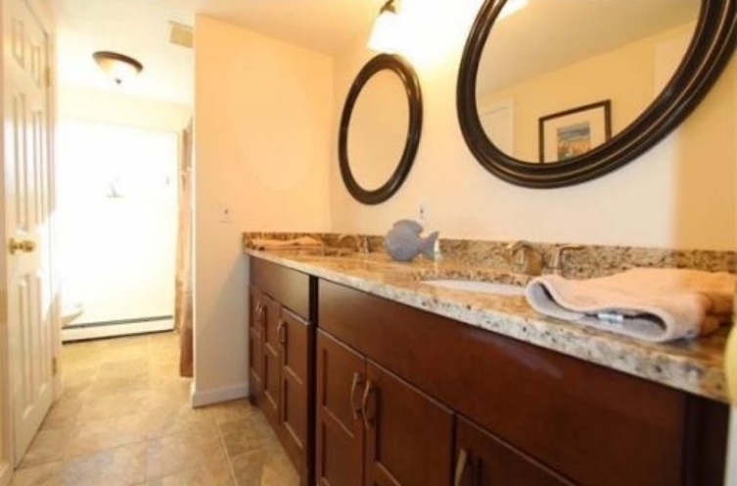
Brady’s Place in Weymouth, MA

Slide 9
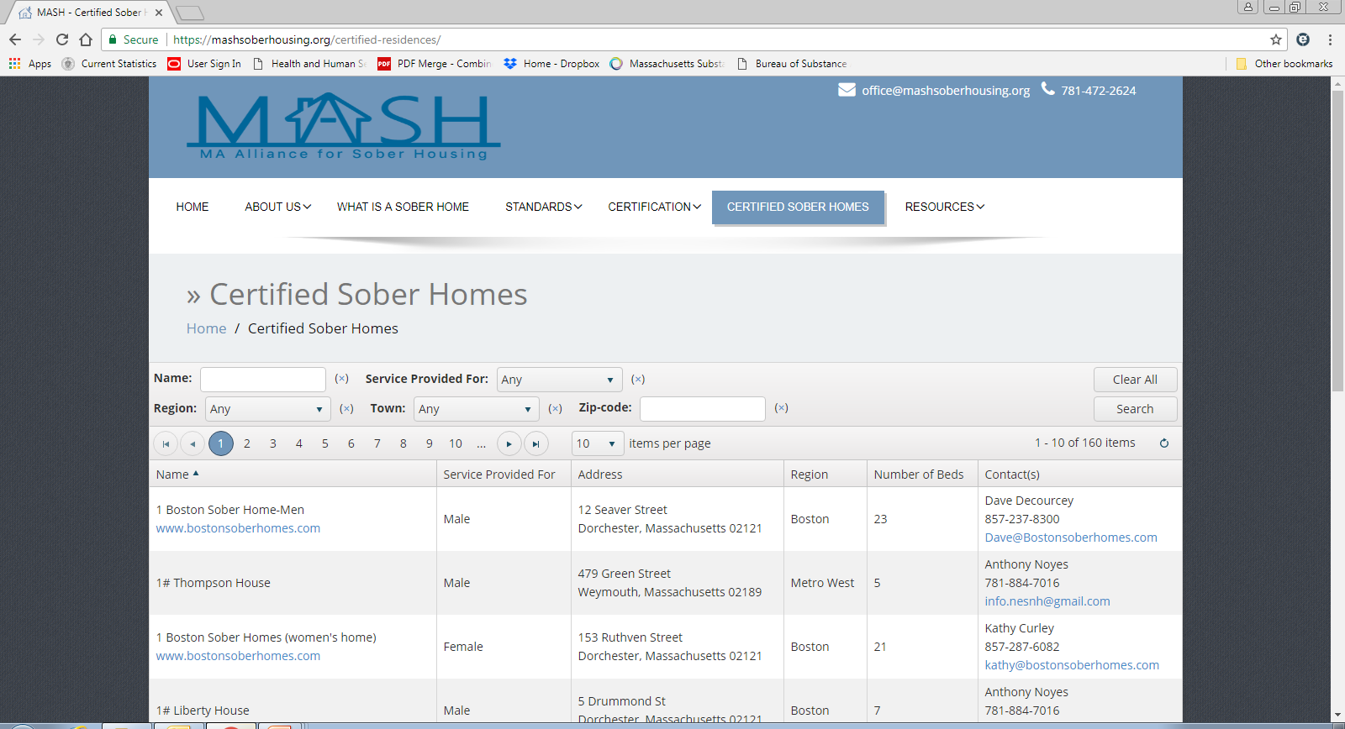
Sober Housing in MA

Slide 10
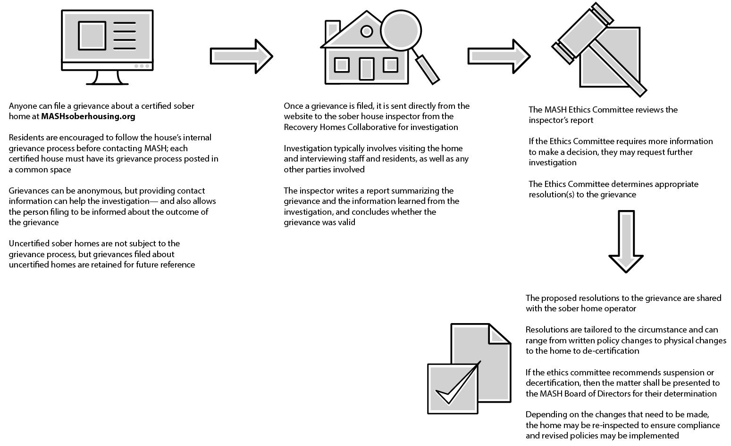
Sober Housing in MA – Grievance Process

Slide 11
Other Initiatives: Recovery Support Centers
BSAS funds 10 Recovery Support Centers in Massachusetts
Examples of Center activities:
Peer support
Relapse prevention
Tobacco cessation support groups
Social events
Access to computers for job searches
Advocacy
Recovery coaching

Slide 12
Other Initiatives: Peer Workforce
1,058 Coaches trained in BSAS-sponsored Recovery Coaching Academies held since 2011
186 new Recovery Coach Supervisors since 2016
403 individuals trained in Ethical Considerations since 2015 (204 since 2017)
30 Certified Addiction Recovery Coaches

Slide 13
Conclusion
Massachusetts Department of Public Health,
Bureau of Substance Addiction Services
www.mass.gov/bsas
Allison F. Bauer, JD, LICSW
(617) 624-5151
Helpline: 800-327-5050
http://www.helpline-online.com

