Slide 1
Overview of the Addiction Technology Transfer Center Network
Holly Hagle, PhD
Co-Director, Addiction Technology Transfer Center, Network Coordinating Office (NCO)
Location of presentation

Slide 2
ATTC Network
Helping people and organizations incorporate effective practices into substance use disorder treatment and recovery services

Slide 3
The 2017-2022 ATTC Network is comprised of:
1 Network Coordinating Office
10 Domestic Regional Centers
1 National American Indian and Alaska Native ATTC
6 International HIV Centers (PEPFAR funded)
Coming soon -1 Targeted Capacity Expansion Hispanic/Latino Center of Excellence for Substance Use Disorder Treatment and Recovery Program

Slide 4
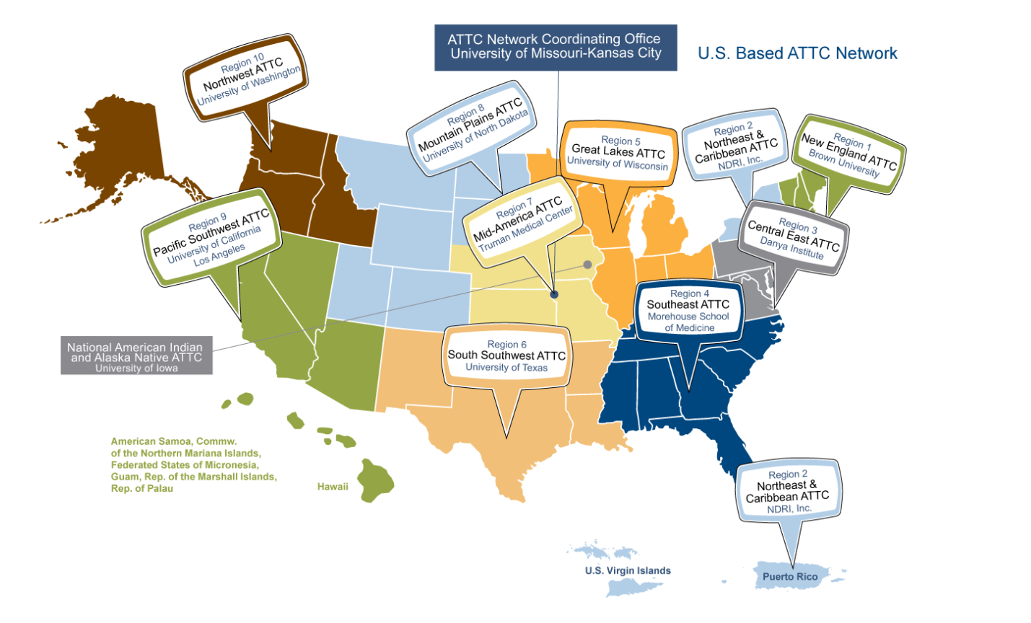
US-Domestic ATTC Network

Slide 5
10 Domestic ATTC Regional Centers
Match the 10 HHS Regions
Address multi-system issues
Provide education, training and intensive technical assistance
Develop region-specific products
Utilize regional advisory boards
Respond to needs of state/regional stakeholders, but may also develop specific areas of expertise
Work to improve standards and policies in the field

Slide 6
Domestic ATTCs’ Mission
Established in 1993 by SAMHSA, the domestic ATTCs:
Accelerate the adoption and implementation of evidence‐based and promising addiction treatment and recovery-oriented practices and services;
Heighten the awareness, knowledge, and skills of the workforce that addresses the needs of people with substance use and/or other behavioral health disorders; and
Foster regional and national alliances among culturally diverse practitioners, researchers, policy makers, funders, and the recovery community.

Slide 7
1 National American Indian and Alaska Native ATTC
Prepares tools and strategies needed to improve the quality of service delivery for tribal communities
Provides intensive technical assistance to improve processes and practices in the delivery of SUD treatment and recovery services for tribal communities

Slide 8
SAMHSA & PEPFAR
Since 2005, SAMHSA has worked with the Vietnam PEPFAR team to address HIV among PWID by enabling Vietnam to transform drug use from a public safety/criminal justice issue to a public health issue.
In September 2014, PEPFAR provided new HQ funding for SAMHSA’s Regional Initiative.
SAMHSA has deployed 3 Regional Special Experts
SAMHSA has established 3 ATTCs in Southeast Asia (covering 8 nations), Ukraine, and South Africa
Through the ATTCs and other projects, SAMHSA provides training and technical assistance in-country
SAMHSA brings expertise in behavioral health to support and respond to PEPFAR needs.

Slide 9
SAMHSA’s Role in PEPFAR
Treatment for Substance Use Disorders
Prevention of Substance Use Disorders and HIV
Anti-Discrimination
Trauma
Recovery
Integration
Policy – Clinical Issues, Training and Technical Assistance

Slide 10
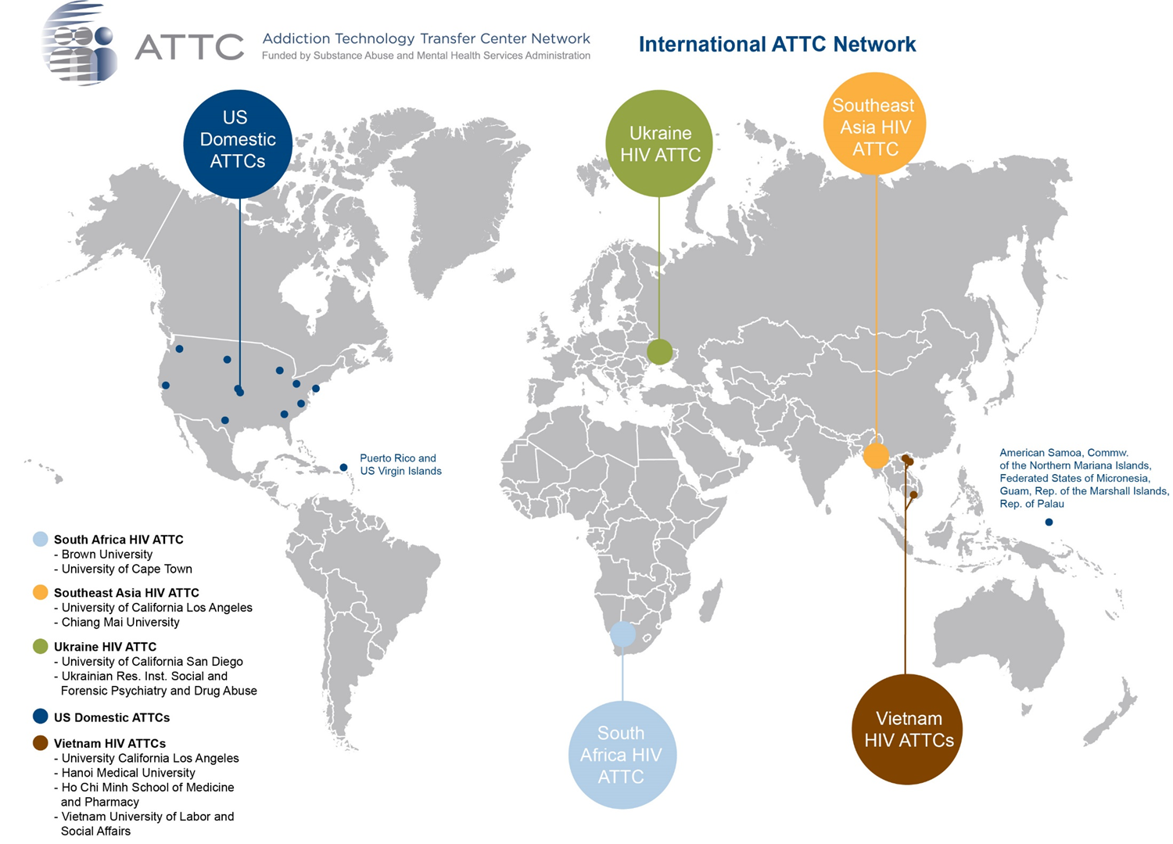
Six International HIV Centers (PEPFAR funded)

Slide 11
Soon to be Funded
1 Targeted Capacity Expansion Hispanic/Latino Center of Excellence for Substance Use Disorder Treatment and Recovery Program
The Hispanic/Latino COE recipient will work directly with SAMHSA and in collaboration with the FY 2017 Addiction Technology Transfer Center (ATTC) National Coordinating Center and the Regional ATTCs on activities aimed at improving the quality and effectiveness of treatment and recovery, as well as working directly with providers of clinical and recovery support services, and others that influence the delivery of services, to improve the quality of workforce training and service delivery to Hispanic/Latino communities.

Slide 12
Primary Work
Through the funding of this effort, SAMHSA expects to support national and regional activities focused on:
1) preparing tools needed by practitioners to improve the quality of service delivery; and
2) providing intensive technical assistance to provider organizations to improve their processes and practices in the delivery of effective SUD treatment and recovery services

Slide 13
Primary Work
The work of the ATTC network is shifting from a focus of primarily training individuals using didactic training approaches to one that works with organizations to develop or improve the quality of services and interventions that are provided across the prevention, treatment, and maintenance (recovery) continuum outlined by the Institute of Medicine.
Using a systems change approach, the goal is to improve organizations and systems of care, enhancing access, engagement, and outcomes based in a continuous quality improvement framework; not limited to training and knowledge enhancement alone.

Slide 14
October 2018 25 Years!

Slide 15
Collaborating at the Regional Level
Shining the Spotlight on Regional Center work with Single State Authority:
Pacific Southwest ATTC and the SSA of Hawaii
Started with a annual training model and developed into long term intensive TA – Systems Change

