Slide 1
Ohio Recovery Support Recovery is Beautiful
Joyce Starr LSW, LICDC-CS, ICADC
Ohio Department of Mental Health and Addiction Services
Chief of Addiction Services
NTN President - NASADAD

Slide 2
In the beginning….. ATR was granted to Ohio
This allowed for the idea of Recovery Support Services outside primary treatment
Variety of services made available for the support of individuals in recovery
Housing was the main one identified as biggest need to sustain recovery
State Departments were still separate agencies but engaged in BRSS TAC Policy academy to create a unified definition of recovery.

Slide 3
The marriage of ODADAS & ODMH- July 2014
ODADAS receives ATR- II, III
ODMH funds Environmental Scan
June 2013
ODMH Capital and Housing Team developing housing strategies
Pre-Consolidation Activities
Peer recovery coach trainings in Ohio for SUD
BRSS TACS
ROSC trainings
Notes:
MH has always worked on housing….strategically working with capital to support MH options for housing.
preconsolidation – working and leverage opportunities to service an integrated approach as we merged.
MH wanted to identify landscape of recovery housing as we began to merge and move forward. Funded a environmental scan. – took a look at policies, gaps, and provided recommendations to state on how to appropriately expand RH in ohio - contract between MH/Ohio Council/C-4 and local recovery housing providers (BOOKLETS) – gave us blue print to follow – took recommendations to follow as we developed further
Married – the department sent combined team to a policy academe my to design how peer services would be designed 0- BRSS TACS
Deliberate on our approach –
developed our state curriculum integrated with both MH/SUD
Now a Medicaid funded service as of July 1 2017

Slide 4
NARR Affiliate: Ohio Recovery Housing
Statewide Definition of Recovery Housing. State Support for capacity expansion
Learning Community (Resource Meetings, Resource HUB)
Statewide Housing Inventory
Peer support trainings continue
Legislation mandates recovery
Housing and peer support in
Continuum of care
July 1, 2017 Peer Support become
A Medicaid eligible service
Notes:
Peer support trainings continued…..
Housing inventory - take stock of how much housing we had in system for both Sud and Mh and how much local boards were spending on housing. - approx. 1 yr. Report on web
it told us some about need in each community – dollars invested for housing and Boards time invested in success of housing
HUB – as result of including providers to the table, they wanted to continue to meet and we hold resource meetings to provide direct training to community recovery housing providers. Resources are on line as a resource
SY15 – STATE put in legislation definition of recovery housing in budget language and provided 15 million to expand RH in Ohio for SUD.
STATE released RFP for agency to develop standards for Ohio Recovery Housing. NARR is currently the only certifying body in Ohio to certify housing

Slide 5
MOVNG OHIO FORWARD…….
TRANSITIONING TO A
RECOVERY-ORIENTED SYSTEM OF CARE…..
Notes:
Ohio association of county behavioral health authorities decided to ramp up state wide recovery support.
Termed it Recovery is Beautiful – to bring together boards, providers and community agencies to focus on patient centered care and utilizing all these agencies to meet the needs of the client in maintaining a productive recovery

Slide 6
“By focusing on recovery supports that are local and person-centered, we can build a service network that finally tears down the service silos and includes the gamut of helpful community resources to meet the needs of peers”
-Jack Cameron -Past Director
Ohio Empowerment Coalition
Notes:
Launched in 2015 – 5-year blueprint
Update in 2017 to include prevention and wellness
2020 – will be updated based on the outcomes of current goals and moved forward with identified need at that time.

Slide 7
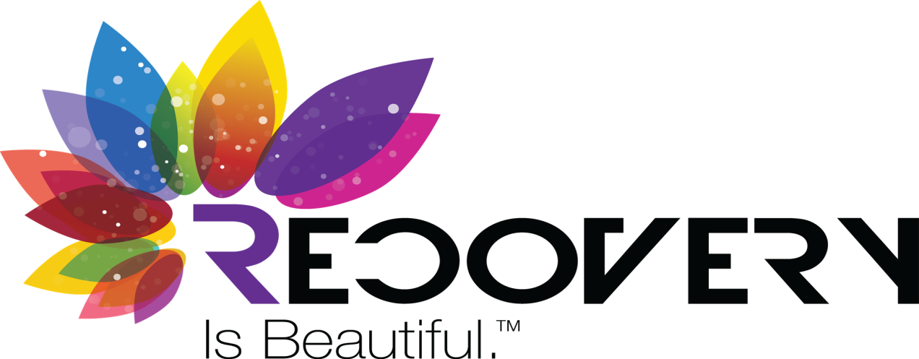
The CASE FOR CHANGE
Ohio's movement to a (ROSC), represents a shift away from crisis-oriented, acute-care treatment to a recovery management approach that provides long-term supports with the recognition that there are many pathways to healing and recovery.
Ohio made the decision to overhaul their entire county-based mental health and addiction system to a Recovery-Oriented System of Care - Ohio's Alcohol, Drug Addiction and Mental Health (ADAMH) Boards, in partnership with individuals in recovery and local stakeholders, are transforming local services and supports to fit within the recovery paradigm.
Notes:
The Backward C is there noting that recovery is not always linear….there are steps backwards at times during the journey but always moving forward
It was an overhaul to our system – it developed partnerships to transform our state, local service and supports to fit in a new way of thinking and providing services that meet the needs for a productive recovery for any individuals.

Slide 8
Changing the Conversation
Recovery Is Beautiful - is a movement providing hope and encouragement while changing the conversation in regards to addiction and mental illness.
ADAMH Boards are helping to reduce the stigma of and discrimination against addiction and mental illness by ensuring that people understand that these are chronic illnesses and that -
Treatment Works – People Recover
Recovery is to be CELEBRATED – individuals in recovery become active, productive, contributing members of their communities!
Notes:
Main focus was to instill hope, encouragement and to begin to look at a chronic illness approach .
Recovery should be celebrated! It is allowing individuals to be active…productive members of the community.

Slide 9
development OF recovery IS BEAUTIFUL
Recovery is Beautiful BluePrint, a five-year plan to transition Ohio’s local community mental health and addiction service systems into Recovery-Oriented Systems of Care (ROSC).
This Blueprint is a framework where Ohio Boards are the Recovery-Oriented System of Care “hub” for their local communities.
There is coordination across systems to ensure that local entities are prepared to offer community-based mental health and addiction services, and recovery supports that are person-centered to meet the needs of individuals working toward recovery.
Notes:
Boards are the HUB for providers and community agencies – business model….
Provide opportunities for task force development to continue to address and manage the integration of MH and AoD and to ensure that recovery supports are there/developed and continue to assist in a well rounded recovery process. The needs for AoD and persistent mental health issues are those individuals who may need long term supports to sustain a productive recovery
Normally in a treatment system – client is center .
In this business model the board is the center – managing and promoting a well rounded support for agencies, providers and families to seek necessary services within the county. Each provider then makes the patient the center in which surrounds the client with appropriate services that are identified for them.

Slide 10
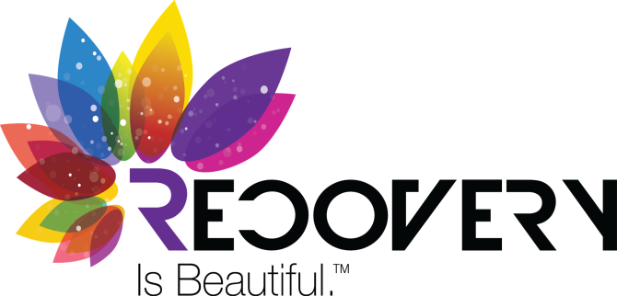
ROSC SELF-ASSESSMENT
The Implementation Committee, in conjunction with input from Lonnetta Albright, Executive Director of the Great Lake Addiction Treatment Transfer Center (GLATTC), Dr. Ijeoma Achara, and Dr. Arthur Evans developed the Recovery-Oriented System of Care (ROSC) Self-Assessment.
This assessment determine community strengths and areas of opportunities within ROSC. This self-assessment process, adopted from multiple national ROSC assessments, focused on the domains of Ohio’s Recovery Is Beautiful BluePrint.
After completion, focus group convened with individuals in recovery, family members and stakeholders to stimulate conversation about the findings.
Notes:
Each board administered to each board area to determine strengths and areas of opportunities that exist and areas needed.

Slide 11
ROSC COMMUNITY REPORTS
After the completion of the ROSC self-assessment and focus groups, each of the ADAMH Boards developed a community report that was disseminated to community partners highlighting the findings of the ROSC self-assessment and focus group discussions.
Notes:
Each county provided a report of finding and developed goals and strategies from the assessment findings./interventions and outcomes.
Reported out to their communities

Slide 12
recovery IS BEAUTIFUL bLUEPRINT
The goals and action steps for Beautiful BluePrint have been update for SFY 2017-2019.
The updates include an added emphasis on prevention and wellness, and continued prioritization of the involvement of individuals in recovery with the community. The five principles are as follow:
Focusing on Clients and Families
Ensuring Timely Access to Care
Promoting Healthy, Safe, and Drug-Free Communities
Prioritizing Accountable and Outcome-Driven Financing
Locally Managing Mental Health and Addiction Systems of Care
Notes:
There are action steps to each of these areas that you can download from the web…. Set for two years at a time…
Focusing on client and families – DRIVE the services ( engagement is essential)
Ensuring timely Access to Care – services that are available – waiting lists….engagement prior
Promoting health , safe, drug free communities – prevention/education crisis services – housing employment and peer support
Prioritizing accountable and outcome driven financing – maximizing the use of federal, state and local funds to meet locally identified outcomes. A blending approach of funding aligns resources and improves coordination of services.
Locally managing MH and AOD system of care – working with local partners and coming together to determine the best needs identified for their community to support recovering individuals in a holistic fashion.
It about hope
It is about Trust
It is about investments tp promote health and recovery.

Slide 13
Questions?
Please contact:
Dontavius L. Jarrells
Community Engagement and Advocacy Administrator
Ohio Association of County Behavioral Health Authorities
(614) 224-1111
Djarrells@oacbha.org
www.oacbha.org

