Slide 2
Federal Guidelines for Opioid Treatment Programs
Melinda Campopiano, MD
Medical Officer
Center for Substance Abuse Treatment
Substance Abuse and Mental Health Services Administration
U.S. Department of Health & Human Services
CSAT/SOTA meeting
Atlanta GA• March 29, 2015

Slide 3
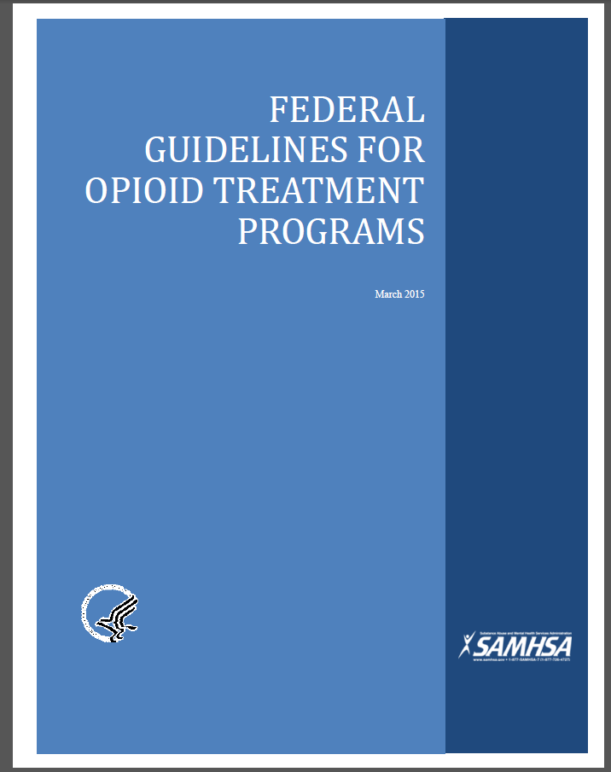
New Federal Guidelines for OTPs
Offer full range of pharmaceuticals for MAT for medically determined necessary tx of clients
Provide recovery-oriented care
Relapse/overdose prevention services
Leverage PDMPs as clinical support tools
Notes:
Sample key highlights….

Slide 4
Federal Opioid Treatment Program Standards
Major change from public comment draft due to language in Part 8.12(h)(4):
OTPs shall maintain current procedures adequate to ensure that each opioid agonist treatment medication used by the program is administered and dispensed in accordance with its approved product labeling. Dosing and administration decisions shall be made by a program physician familiar with the most up-to-date product labeling. These procedures must ensure that any significant deviations from the approved labeling, including deviations with regard to dose, frequency, or the conditions of use described in the approved labeling, are specifically documented in the patient's record.

Slide 5
Possible Means to Address the Role of Advanced Practice Nurses and Physician Assistants
Exemptions allowed in Part 8.11(h): An OTP may, at the time of application for certification or any time thereafter, request from SAMHSA exemption from the regulatory requirements set forth under this section and §8.12.
An example of a case in which an exemption might be granted would be for a private practitioner who wishes to treat a limited number of patients in a non-metropolitan area with few physicians and no rehabilitative services geographically accessible and requests exemption from some of the staffing and service standards.

Slide 6
OTP Justification for Exemption
The OTP shall support the rationale for the exemption with thorough documentation, to be supplied in an appendix to the initial application for certification or in a separate submission.
SAMHSA will approve or deny such exemptions at the time of application, or any time thereafter, if appropriate.
SAMHSA shall consult with the appropriate State authority prior to taking action on an exemption request.

Slide 7
Proposed Exemption Process
What is required in the 42CFR Part 8:
OTPs shall support the rationale for the exemption with thorough documentation.
SAMHSA will not approve unless state supports the request.

Slide 8
Sample Request for Exemption

Slide 9
Sample Response to Request for Exemption

Slide 10
Possible Regulatory Review and Revision
Long-Range Response to Short-Comings of Federal Opioid Treatment Program Standards
Satisfy Executive Order and Request from Congress to update 42 CFR Part 8.
Could include:
Amend 8.12(h)(4) to allow APNs and PAs
Clarify confusion language regarding provider responsibilities elsewhere.

Slide 11
THANK YOU,
Melinda.Campopiano@samhsa.hhs.gov

