Slide 1
Opioid addiction treatment: Challenges (and opportunities) for community practice
Marc Fishman MD

Slide 2
Relapse prevention medication as the standard of care
Persuading patients
Persuading families
Persuading criminal justice system
Persuading SUD providers, especially residential treatment
Persuading payers
Persuading the recovery community

Slide 3
Treatment matching options Choice of medications
Methadone
Buprenorphine
Extended release naltrexone

Slide 4
Providing a full continuum of care
Inpatient detoxification and stabilization
Short term residential treatment
Long term residential treatment
Day treatment / partial hospitalization
Assisted living support for outpatient treatment (IOP plus/ PHP plus)
Recovery housing

Slide 5
Linking patients to medical care
Embedding medical care in opioid specialty settings
Providing opioid treatment for stable patients in general medical settings
Medical home models

Slide 6
Linking patients to psychiatric care
Embedding psychiatric care in opioid specialty settings
Providing opioid treatment for stable patients in mental health settings
Integrated care models (eg Integrated Dual Disorder Treatment -- IDDT)

Slide 7
Providing additional support for struggling patients
Direct medication administration (in non-OTP)
7 day services: weekends and evenings
Case management services
Family services
Vocational services
Recreational/social services
Assertive outreach for extended engagement

Slide 8
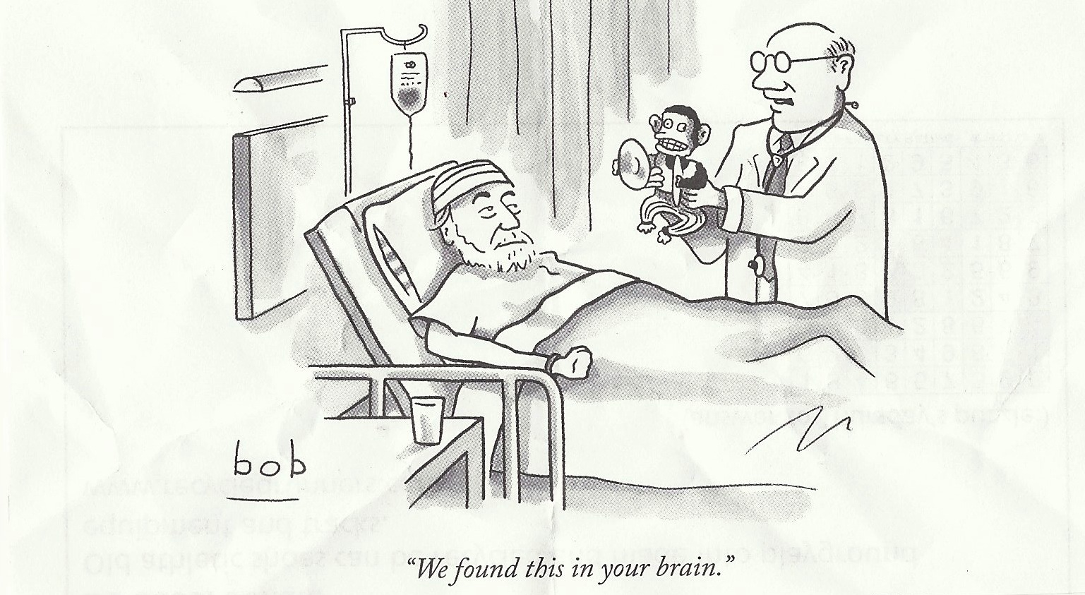
If only it were that easy

