Slide 1
Opioid Crisis in New England
Hilary Jacobs, LICSW, LADC I
Senior Policy Advisor
Bureau of Substance Abuse Services
hilary.jacobs@state.ma.us

Slide 2
AGENDA
Nature and Scope of the Opioid Problem
National
New England
How We Got Here
Strategies for Addressing the Problem
National
New England

Slide 3
National Picture
2012
2.1M SUD related to opioid pain relievers
467,000 addicted to heroin
14.4% of pregnant women were prescribed an opioid during pregnancy
Unintentional opioid overdose death has quadrupled since 1999

Slide 4
Fatal and Non-fatal Overdoses
 | Fatal | Year of Data | 2014 Census Estimate*
CT | 344 | 2014 | 3,596,677
MA | 978*estimated 868 confirmed | 2013 | 6,745,408
ME |  |  | 1,330,089
NH |  |  | 1,326,813
RI | 208 | 2014 | 1,055,173
VT |  |  | 626,562

Slide 5
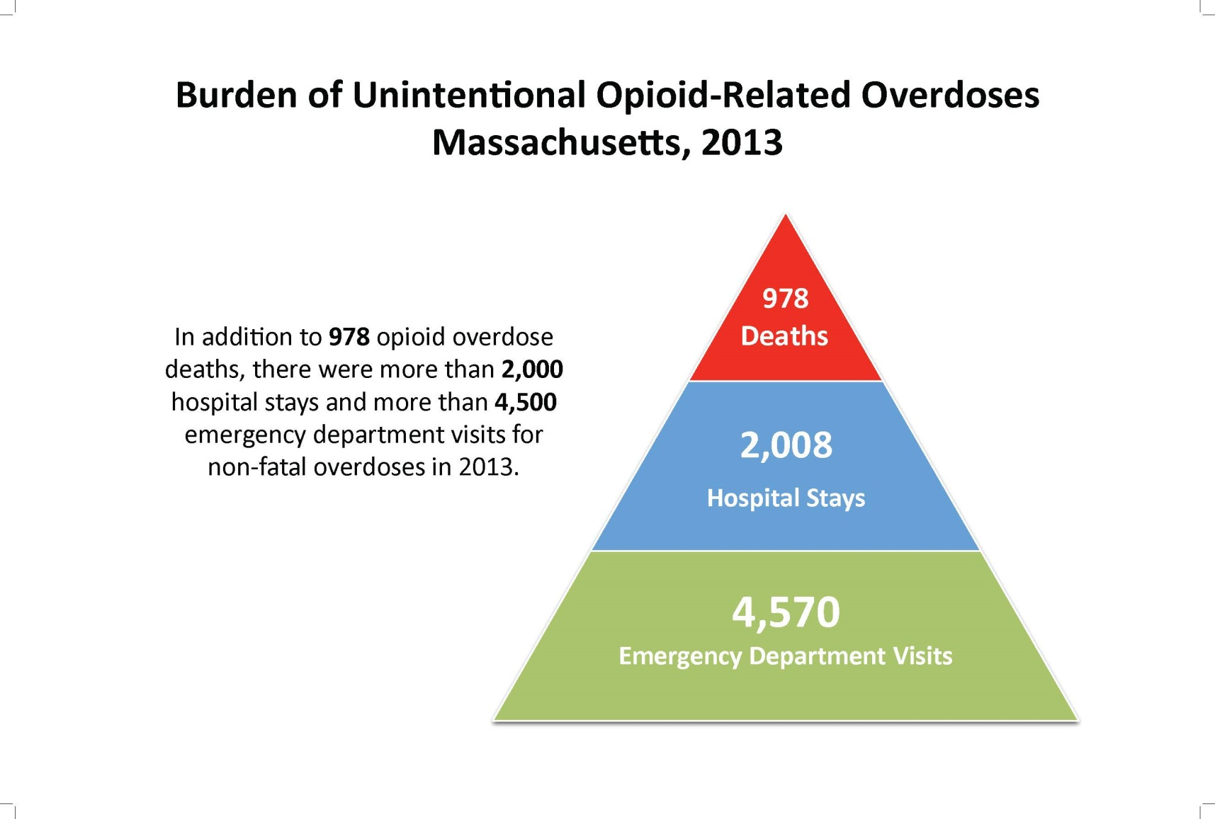
Scope of the Problem
868 confirmed deaths, 978 estimated deaths Source: Office of Data Management and Outcomes Assessment February 2015

Slide 6
National Past Year Initiates for Specific Illicit Drugs among Persons Aged 12 or Older, 2012
Source: SAMHSA, National Survey on Drug Use and Health, 2012
Notes:
http://www.samhsa.gov/data/NSDUH/2012SummNatFindDetTables/DetTabs/NSDUH-DetTabsSect4peTabs1to16-2012.htm#Tab4.5B

Slide 7
Past Year Nonmedical Pain Reliever Use by Age Group in US & New England States, 2011-2012
Nonmedical use of prescription-type psychotherapeutics includes the nonmedical use of pain relievers, tranquilizers, stimulants, or sedatives and does not include over-the-counter drugs.
Source: SAMHSA, National Survey on Drug Use and Health, 2011-2012

Slide 8
Where Pain Relievers Were Obtained for Most Recent Nonmedical Use among Past Year Users Aged 12 or Older, United States, 2011-2012
Source Where Respondent Obtained
Bought on Internet 0.2%
Drug Dealer/ Stranger 4.3%
Other ¹ 5.0%
Source Where Friend/Relative Obtained
More than One Doctor
1.8%
More than One Doctor 3.6%
Free from Friend/Relative 5.4%
One Doctor
19.7%
Free from Friend/Relative 54.0%
One Doctor
82.2%
Bought/Took from Friend/Relative 5.4%
Bought/Took from Friend/Relative 14.9%
Drug Dealer/ Stranger 1.4%
Other ¹ 1.8%
Bought on Internet 0.2%
Source: SAMHSA, Center for Behavioral Health Statistics and Quality, National Survey on Drug Use and Health, 2011-2012.
Note: Totals may not sum to 100% because of rounding or because suppressed estimates are not shown.
¹ The Other category includes the sources: “Wrote Fake Prescription,” “Stole from Doctor’s Office/Clinic/Hospital/Pharmacy,” and “Some Other Way.”
Notes:
Miranda – edited 4/28/2014

Slide 9
Relationship Between Prescription Medication and Heroin Use
Nonmedical use of prescription drugs (NMPR)*:
Drugs that were not prescribed for the person taking them OR;
Drugs used only for the experience of feeling they caused
*National survey on Drug Use and Health definition
Access is a factor in misuse, abuse and addiction to all substances of abuse
While most individuals who use pharmaceutical opioids do not transition to heroin use, some do
When this happens the process often begins with NMPR use
When pharmaceutical opioids are used non-medically the route of administration is sometimes altered (snorting or injecting)
4 out of 5 recent heroin initiates used pain relievers non-medically preceding first heroin use**
Previous heroin use has not been shown to relate to onset of NMPR use**
Substance Abuse and Mental Health Services Administration Center for Behavioral Health Statistics and Quality August 2013
“Associations of Nonmedical Pain Reliever Use and Initiation of Heroin Use in the United States”, Pradip K. Muhuri, Joseph C. Gfroerer, M. Christine Davies

Slide 10
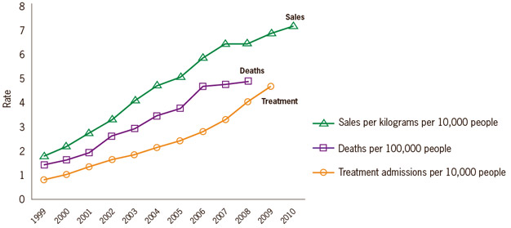
Prescription opioid sales, deaths and treatment: 1999-2010
National Vital Statistics System, 1999-2008; Automation of Reports and Consolidated Orders System (ARCOS) of the Drug Enforcement Administration (DEA), 1999-2010; Treatment Episode Data Set, 1999-2009

Slide 11
Other Factors
1995 “Pain as the fifth vital sign”
Idea endorsed by the VA and the Joint Commission
2006 CMS adopted a standardized quality measure that rates hospitals/doctors on patient satisfaction with pain management “Hospital Consumer Assessment of Healthcare Providers Report”
Report measures 8 domains (dimensions)
Pain management one dimension
Scores are related to incentive payments hospitals receive
2011 IOM publishes “Relieving Pain in America”

Slide 12
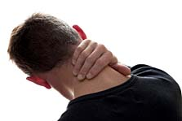
Other Factors
US is one of two countries that allows direct to consumer pharmaceutical advertising¹
US consumes 80% of world’s narcotic prescription medications²
99% of the world’s hydrocodone (Vicodin)²
Heroin is cheap, pure and sometimes adulterated

Slide 14
Opioid Overdose Prevention Policies
The Trust for America’s Health Prescription Drug Abuse: Strategies to Stop the Epidemic 2013 provides a snapshot of the range of evidence-informed policies in place in different states.
Zero is the lowest possible overall score (no policies in place), and 10 is the highest (all the policies in place)

Slide 15
INDICATORS
Prescription Drug Monitoring Program: Does the state have an operational Prescription Drug Monitoring Program?
Mandatory Use of PDMP: Does the state require mandatory use of PDMPs by providers? (any form of mandatory use requirement)
Doctor Shopping Law: Does the state have a doctor shopping statute?
Support for Substance Abuse Services: Has the state expanded Medicaid under the Affordable Care Act, thereby expanding coverage of substance abuse treatment?
Prescriber Education Requirement: Does the state require or recommend education for prescribers of pain medications?
Good Samaritan Law: Does the state have a law in place to provide a degree of immunity from criminal chargers or mitigation of sentencing for an individual seeking help for themselves or others experiencing an overdose?
Support for Naloxone Use: Does the state have a law in place to expand access to, and use of, naloxone for overdosing individuals given by lay administrators?
Physical Exam Requirements: Does the state require a healthcare provider to either conduct a physical exam of the patient, a screening for signs of substance abuse or have a bona fide patient-physician relationship that includes a physician examination, prior to prescribing prescription medications?
ID Requirement: Does the state have a law requiring or permitting a pharmacist to ask for identification prior to dispensing a controlled substance?
Pharmacy Lock-In Program: Does the state’s Medicaid plan have a pharmacy lock-in program that requires individuals suspected of misusing controlled substances to use a single prescriber and Pharmacy?

Slide 16
State Scores
10 (2 states) | 9 (4 states) | 8 (11 states) | 7 (5 states) | 6 (11 states & D.C)
New Mexico Vermont | Kentucky Massachusetts New York Washington | California Colorado Connecticut Delaware Illinois Minnesota North Carolina Oklahoma Oregon Rhode Island West Virginia | Florida Nevada New Jersey Tennessee Virginia | Arkansas D.C. Georgia Hawaii Iowa Louisiana Maryland Michigan North Dakota Ohio Texas Utah
5 (8 states) | 4 (6 states) | 3 (2 states) | 2 (1 state)
Alaska Idaho Indiana Maine Mississippi Montana New Hampshire South Carolina | Alabama Arizona Kansas Pennsylvania Wisconsin Wyoming | Missouri Nebraska | South Dakota

Slide 17
 | CT | MA | ME | NH | RI | VT
First Responder Naloxone | State Police mandate; other first responders voluntary | Yes | Yes | Yes | Yes | Yes
Bystander Naloxone | Yes | Yes | Yes | In progress | Yes | Yes
ED Intervention for non-fatal overdose | No | No | No | No | Yes | No
Medicaid payment for all 3 MAT | Yes/No Limit | Yes/No Limit | Yes/Limit Buprenorphine & Methadone. 2yr limit for both | Yes/No limit | Yes/No limit | Yes
Peer Recovery Coaches | Yes, telephone | Yes | Yes | Yes | Yes | Yes
Recovery Support Centers | Yes | Yes | Yes | Yes | Yes | Yes
Recovery High Schools | No | Yes | No | No | Yes | No
Interstate PMP Data Sharing | Yes | Yes | No | In process | Not Yet | In process
Safe Opioid Prescribing Regulations | “Guidelines” only | ED Guidelines only | No | Yes | Yes | Yes
Naloxone Pharmacy Access/standing order | Leg pending allowing pharmacists to prescribe over the counter | Yes | No | No | Yes | In process

Slide 18
Other Innovations
Regional Approach
Safe Opioid Prescribing; Prevention Messaging; Law Enforcement; Cross Border Tx Access; Interstate PMP Data Sharing
Set limits on MME
Require commercial payment for MAT under parity
MA specific:
Pairing treatment providers with first responders
PMP Alerts
Linking data on suspected opioid overdose victims with PMP and SUD treatment data
Working with licensed providers about what they can do

Slide 19
MA “Touchstones”
Robust response requires a public health and public safety approach
Beginning to explore replicating the NJ Drug Monitoring Initiative model
Communicating everyone has a role in responding
Idea of “Touchstones”

Slide 20
REMEMBER
TREAT ADDICTION
SAVE LIVES

